Slide 1
Healthy eating habits
Team Broccoli
Danni Li — 45008753
Edward Carroll — 44806336
Mingyang LYU — 45037481
Ziyi Xu — 45480171
Stand-up 2

Slide 2
01
02
DOMAIN
EVALUATION & IDEA CHANGE
03
04
PROTOTYPE
NEW CONCEPT

Slide 3
01.
DOMAIN
Healthy eating habits & lose weight

Slide 4
02.
EVALUATION & IDEA CHANGE
Feedback & change reasons

Slide 5
Problems from evaluation:
If we do an App, functions are so complicated for users that they will not keep using this app .
Letting users manually and actively input food data is a burden for them.
So many notifications from apps may make the users feel annoying.
Although cultivating a pet is attractive, it is really hard to connect a pet’s condition with what users eat and users said they are not clear about calories of the food they eat.

Slide 6
03.
NEW CONCEPT
Main functions & Scenario

Slide 7
MAIN FUNCTIONS
PHOTO RECOGNITION
BARKING & color change
SOCIAL
There's a camera in one eye of the pet, which can recognize what the user eat.
If the user eat junk food, it will bark and won’t play with him/her.
When two or more pets meet face to face, they will sing together.

Slide 8
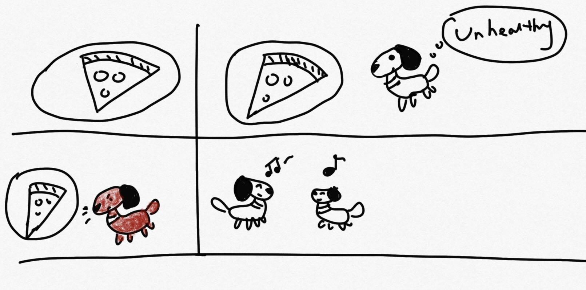
SCENARIO
Mary is a 20-year-old college student who wants to get into a healthy eating habit and lose weight. The reason she USES this product is that every time she eats junk food, she starts to regret it, so she wants something to remind her to keep eating healthy. She made a pizza for dinner tonight, her pendant dog's eyes recognized that the pizza was not healthy, and it’s appearance began to turn red and bark angrily.
Later, Mary's friend came to visit her house. Her friend also had a pendant dog. When Mary's friend brought her pendant dog, their pendant dogs met and began to sing.

Slide 9
04.
PROTOTYPE

Slide 10

Colour changes
Photo recognition (camera)
Barking (speaker)
Interacts with other dogs

Slide 11
QUESTIONS?

Slide 12
THANKS!

